Slide 1







Trends in Data Analytics
Sam Vongratana
March 2023

Slide 2
Trends in Data Analytics
The modern world is based on technology and technology is rapidly every changing.
To remain competitive, review of the technology landscape is for identifying threats and opportunities

Slide 3



OUTLINE
Executive Summary
Introduction
Methodology
Results
Visualization – Charts
Dashboard
Discussion
Findings & Implications
Conclusion
Appendix

Slide 4

EXECUTIVE SUMMARY
Cutting edge technology can be a competitive advantage.
Research was conducted to evaluate the current and future technologies :
Programming Platforms
Databases
Demographic of independent respondents.
With new technologies available, there is a shift away from proprietary solutions to more open source options.
If survey respondents mirror the actual population, men significantly out number women in database related programming fields around the world.

Slide 5

INTRODUCTION
What are the top programming languages in demand currently? And where are they headed in the near future?
What are the top database currently in demand? And where is that demand expected to go in the near future?
What is the current demographic of programmers and database administration?
What is the current gender breakdown?
What kind of education do these people currently have?
What do the compensation trends look like for these positions?
These are things we need to know if the organization is to pivot in the right technological direction.

Slide 6

METHODOLOGY
Information was collected from recent industry surveys.
Investigation was focused on the Language Platform and Databases currently being used and compared against near future available options.
In Demographics of respondents are Worldwide. Gender was considered.
Data was cleaned and analyzed using Python graphs and evaluated.

Slide 7
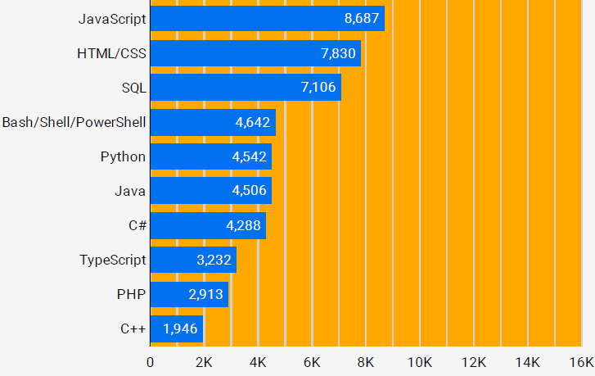
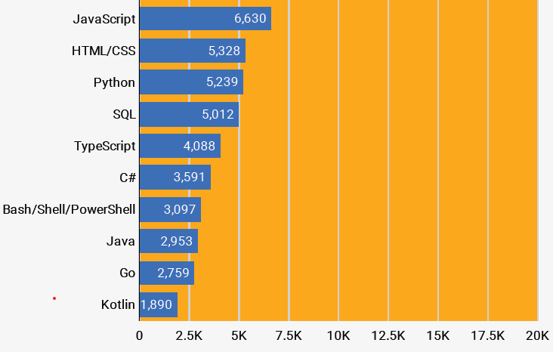
PROGRAMMING LANGUAGE TRENDS
Current Year
Next Year

Slide 8
PROGRAMMING LANGUAGE TRENDS - FINDINGS & IMPLICATIONS
Findings
Javascript and HTML remain at the top of the list for the near future.
Popularity of Python is on the rise.
The curve appears to be flattening over time.
Implications
While the historically popular languages are still high, other options are encroaching.
New and open source options are available.
There is not enough information to determine why there is a shift in popularity.

Slide 9
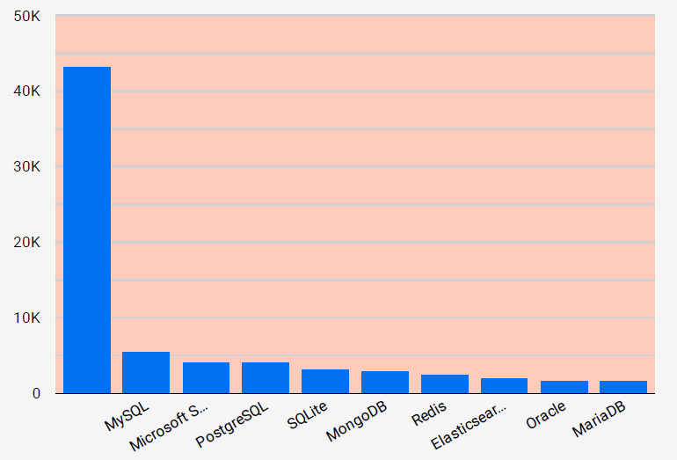
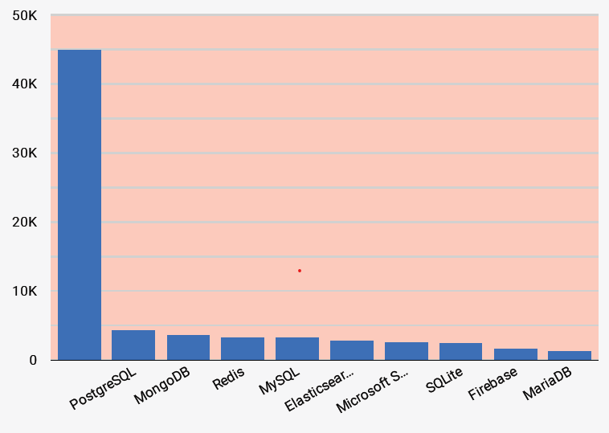
DATABASE TRENDS
Current Year
Next Year

Slide 10
DATABASE TRENDS - FINDINGS & IMPLICATIONS
Findings
Landscape appears to be changing.
MySQL and Microsoft SQL fell from the top to middle of the list.
Former powerhouse Oracle has fallen completely off the list.
Implications
New features and cost may be driving the shift.
Open Source options appear to be popular over Proprietary options.
Additional research is needed to identify the motivation in shift.

Slide 11

DASHBOARD
Current Technology Dashboard
Future Technology Dashboard
Demographic Dashboard

Slide 12
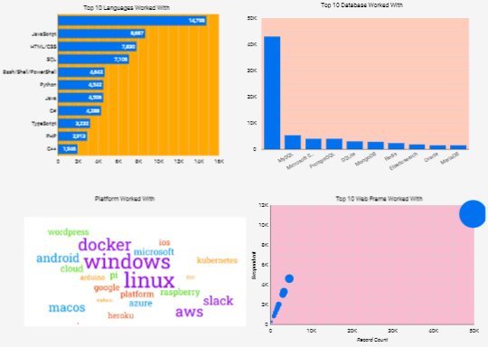
Current Technology

Slide 13
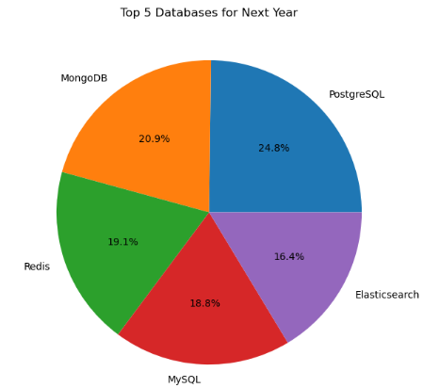
Top 5 Desired Databases

Slide 14
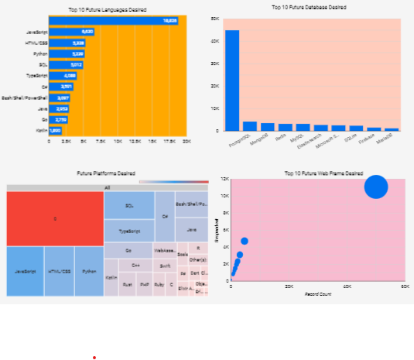
Future Technology

Slide 15
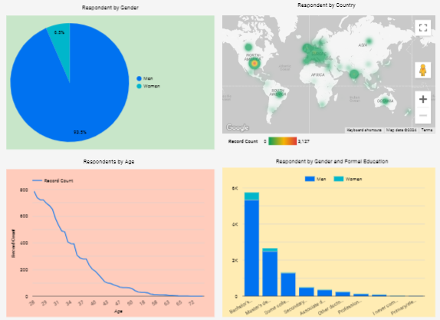
Demographics

Slide 16
DISCUSSION
For the most part, the popularity of programming platforms is mostly unchanged, though there is some shift as shown in the current and future platform graphs.
Newer Database options are having a change in the database landscape. Open Source is becoming popular over proprietary options.
Changes in technology either means hiring new personnel or retraining existing ones.

Slide 17

CONCLUSION
Updating or adding new technology can be a competitive advantage to the organization, but comes with some cost.
Analysis of current and future trends are needed to make good, positive decisions.
With the technological changes, changes in personnel as a resources, whether new or retrained, need to be considered as part of the equation.

Slide 18

APPENDIX
Data collected came from Stack Overflow Developer Survey 2019
Respondents were asked to fill out a survey. The data collected from the surveys span a wide array of subjects and were asked to anonymously detail their personal demographics.
The results of that survey were used for this study.

